Slide 1


A Distributed Concurrent Design based
e-Learning approach to Entrepreneurship Education
Demosthenes Stamatis (demos@it.teithe.gr)
Dept. of Information Technology, ATEI of Thessaloniki, Greece
Börje Hansson
Dept. of Information Technology & Media, Mid Sweden University
Tor Alte Hjeltnes
The Research Foundation TISIP, Trondheim, Norway
Lachlan MacKinnon
Dept. of Computing & Information Systems, University of Greenwich, UK
The dCCDFLITE Project
(Flexible Learning in Information Technology and Entrepreneurship)
http://flite-proj.cenfim.pt/
ICEIRD 2015 Sheffield, 18-19 June 2015

Slide 2
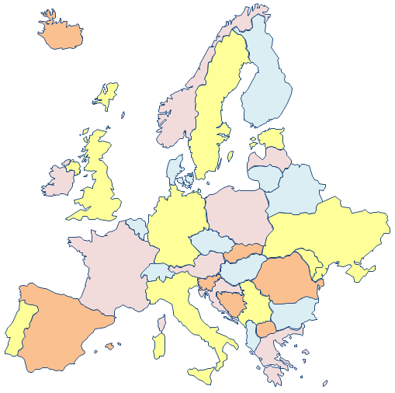
TISIP & Hist - Norway
Miun - Sweden
AFOX - Denmark
UoG - UK
Xlab - Slovenia
CENFIM - Portugal
ATEI - Greece
ICEIRD 2015 Sheffield, 18-19 June 2015

Slide 3

A Distributed Concurrent Design based
e-Learning approach to Entrepreneurship Education
Course Aims and Objectives
Target group of the course
What makes this course different
The dCCD methodology: People-Tools-Processes
First conclusions from running the course
What happens now - The future
ICEIRD 2015 Sheffield, 18-19 June 2015

Slide 4
Course Aims and Objectives
(knowledge)
Students should understand what entrepreneurship is about and relevant issues regarding business and economy issues connected to it.
Students should be able to work both independently and in the context of a group towards the development of a business model and business plan.
Students should know where they can find relevant information and knowledge and be able to continue their development on entrepreneurial abilities.
ICEIRD 2015 Sheffield, 18-19 June 2015

Slide 5
Course Aims and Objectives
(Skills )
Students should be able to contribute in Concurrent Design work (use of dCCD Methodology)
Students should be able to use tools such Osterwalder Canvas (Business Model You) to identify and document their existing entrepreneurial knowledge and skills as well as to develop a Personal Learning Network (PLN).
Students should be able to use Osterwalder Canvas (Business Model Generation) for specifying a business opportunity.
ICEIRD 2015 Sheffield, 18-19 June 2015

Slide 6
Course Aims and Objectives
(Competence )
The students should have the self-confidence to carry out tasks connected to Entrepreneurship in a natural way.
The students will be able to collaborate with key people in order to deal with the appropriate processes and procedures for setting up a business (i.e raising financial capital)
ICEIRD 2015 Sheffield, 18-19 June 2015

Slide 7
Target group of the course
Mainly ICT (+ Business) final year students
ICT (+ Business) Graduates or Post Graduate students
Motivated in the sense that they are looking for a possibility to start a business
With limited available time looking for an Intensive course on Entrepreneurship
ICEIRD 2015 Sheffield, 18-19 June 2015

Slide 8
Specific Target Groups of the Course
(From Small Scale Pilot to MOOC)
A limited number of 12-15 learners (small scale pilot)
Increased a bit to 1500 learners (large scale pilot)
The learners are chosen internally from the partner institutions (small scale pilot)
Internationally (large scale pilot)
Learners work in cross-sectoral, intercultural sub-groups.
ICEIRD 2015 Sheffield, 18-19 June 2015

Slide 9
Purpose of Running the Course (in Pilot Mode)
To test the course on a scale small enough to allow
for in-depth evaluation of the processes at work
The project team, the Quality Board and students of the pilot evaluated the 1st version of the course (contents and activities ) before it will run during a 2nd large scale pilot
Rapid usability testing of the LMS system and tools used for the delivering of the course (HCI testing)
ICEIRD 2015 Sheffield, 18-19 June 2015

Slide 10
The Student View
Hello FLITE group,
I am looking for partners and IT startup ideas
I'm wondering if it is possible to find partners to form an ICT startup company. I'm open to business ideas and I imagine the business to be international.
My specialization area is Artificial Intelligence and I am very familiar with Intelligent Agents and Multi-Agent Systems. I have worked with a project having to do with the development of an Intelligent Personal Agent for Business travelers.
I'd like to brainstorm with you people to find interesting commercial applications.
I don't have any knowledge how to run a business concerning economic, marketing and financial issues, so I hope the FLITE intensive course experience and the communication with you, could somehow fill this gap.
All the best
Dimitris Stamatakis, ICT Graduate and Future Entrepreneur
ICEIRD 2015 Sheffield, 18-19 June 2015

Slide 11
What makes this course different
The course is considered an e-Learning/Blended Learning type of course.
The training will be online, offered over a period of 8 weeks, both asynchronously and synchronously
and requires at least 50 hours of study.
ICEIRD 2015 Sheffield, 18-19 June 2015

Slide 12
What makes this course different
With the aim to choose an innovative idea and turn it in to a business plan for forming a start-up company :
Students will be using a methodology called dCCD process and specific tools for personal and business development, namely Osterwalder Canvas Model YOU and Osterwalder Business Model Generation.
They will be trained in early stages of the course for the use of the above process and tools.
ICEIRD 2015 Sheffield, 18-19 June 2015

Slide 13

What makes this course different
Special emphasis is given on an effective combination of self-directed learning based on well prepared, well-structured course material and computer supported collaborative work in small groups. Students are asked to form groups until week 3 of the course
ICEIRD 2015 Sheffield, 18-19 June 2015

Slide 14
What makes this course different
In the context of the group students should discuss and choose an innovative idea which will act as the basis for the entrepreneurship learning process and the relevant Business Plan development.
ICEIRD 2015 Sheffield, 18-19 June 2015

Slide 15



What makes this course different
Regarding the study of the suggested course material students are advised to initially split the work between them and then present it and discuss it with the rest of the people either in group or between groups.
ICEIRD 2015 Sheffield, 18-19 June 2015

Slide 16
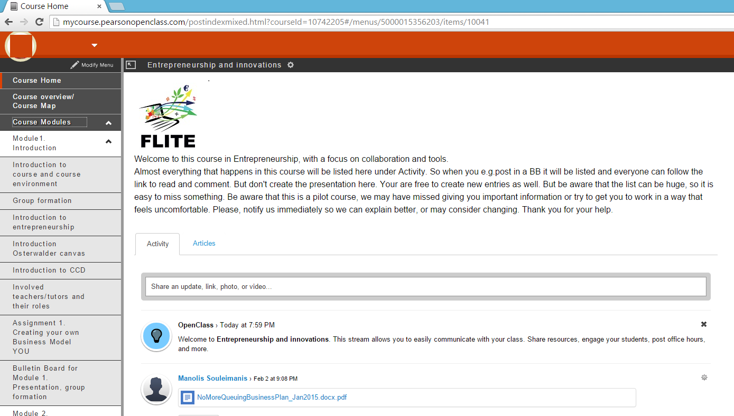
Small Scale Pilot LMS (pearsonopenclass)
ICEIRD 2015 Sheffield, 18-19 June 2015

Slide 17
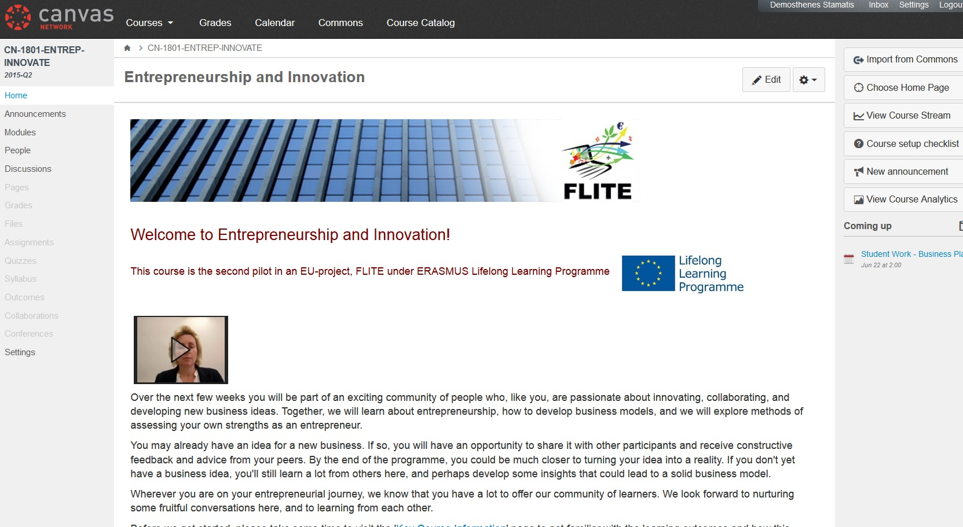
Large Scale (MOOC) Pilot LMS (canvas)
Massive Open Online Course
ICEIRD 2015 Sheffield, 18-19 June 2015

Slide 18
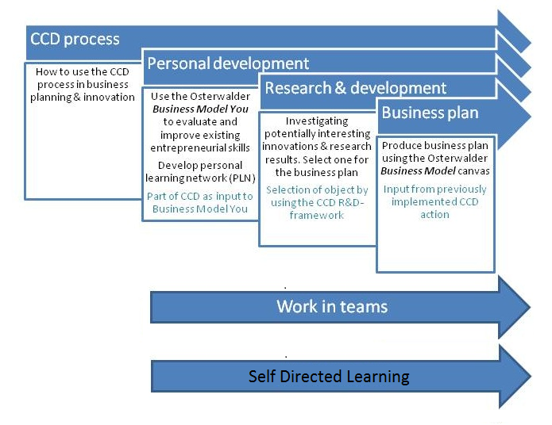
Learning Scenario for course development (and delivery)
ICEIRD 2015 Sheffield, 18-19 June 2015

Slide 19
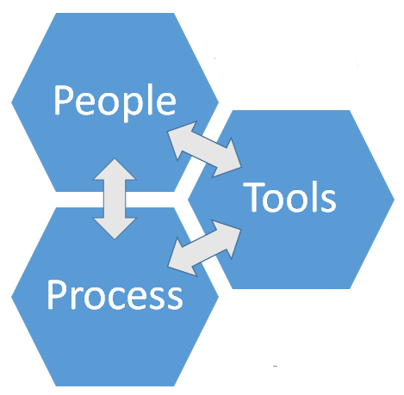
The distributed Concurrent Design (dCCD) Methodology
Students
Tutors
Facilitators
Key People
Osterwalder Canvas
    - Model You
    - Business Model Generation
Cloud Documents Rep
Communication Tools
Collaboration
Self-Directed Learning
Working Sessions/Meetings
Updating Activity Lists
Updating Decision Lists
ICEIRD 2015 Sheffield, 18-19 June 2015

Slide 20
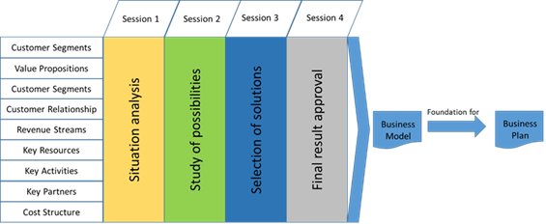
The distributed Concurrent Design (dCCD) Process
Working Sessions Video Meetings
ICEIRD 2015 Sheffield, 18-19 June 2015

Slide 21
Business Model YOU: example
ICEIRD 2015 Sheffield, 18-19 June 2015

Slide 22
Business Model YOU: example
ICEIRD 2015 Sheffield, 18-19 June 2015

Slide 23
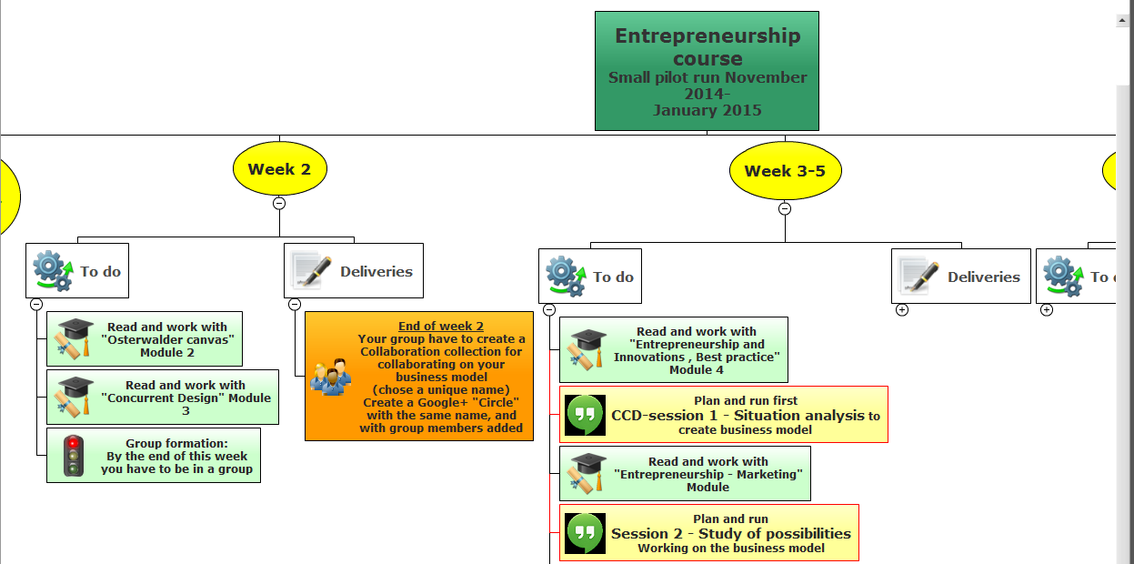
Suggested Timeline for course activities
ICEIRD 2015 Sheffield, 18-19 June 2015

Slide 24
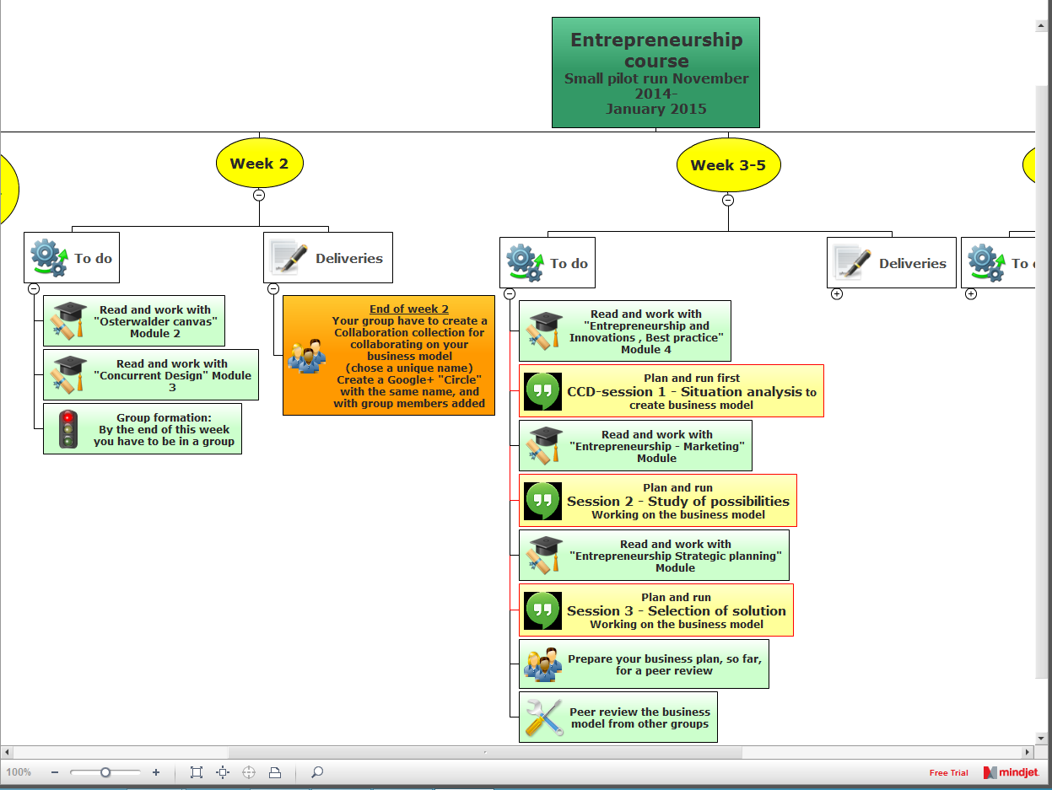
Dr Demosthenes Stamatis (Demos)
Professor, Department of Information Technology
ICEIRD 2015 Sheffield, 18-19 June 2015

Slide 25
Conclusions
(as discussed during the presentation)
Future Work
ICEIRD 2015 Sheffield, 18-19 June 2015

Slide 26
Thank you very much!
Questions?
ICEIRD 2015 Sheffield, 18-19 June 2015

